Slide 1
Creating your first PowerShell module in C#
Emanuel Palm & Justin Grote

Slide 2

Many thanks to our sponsors:

Slide 3


Emanuel & Justin

Slide 4

Agenda
Intro to C# module development
Tooling Options
Follow along 💻
Anatomy of a C# project
dotnet build, publish & more
Lots of code and examples!
https://github.com/PalmEmanuel/YourFirstPSModuleInCSharp

Slide 5
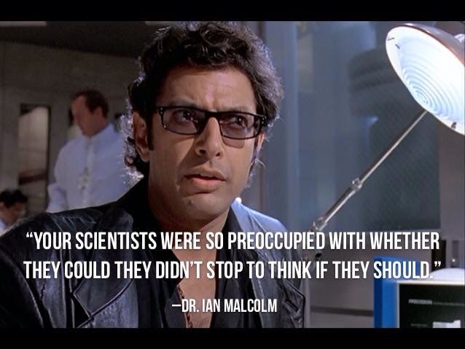

Slide 6
Why
Leverage the .NET ecosystem
NuGet packages and closed-source SDKs
Implement extensible APIs in a more robust way
.NET features that aren’t in PowerShell
Type safety
Generic methods
Interfaces
…

Slide 7
Useful Scenarios
Interacting with APIs that have an SDK available
Not reinventing the wheel

Slide 8
A few C# or hybrid modules
Pester
PSBicep
PrtgAPI
Most of Microsoft’s official modules
Mortar
AzBobbyTables
PoshAnywhere
More modules than you expect

Slide 9
Tooling
.NET SDK
PowerShell (Build Scripts and Interactive Troubleshooting)
Code Editor
Visual Studio Code
C# Dev Kit (Very new!)
Visual Studio (Community Edition available)
Jetbrains Rider
Any text editor
Notepad (please don’t use notepad)

Slide 10
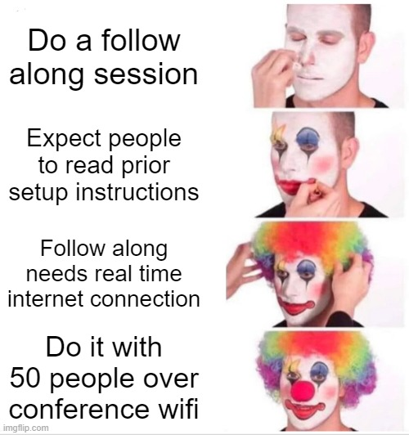

Slide 11
Follow along!
QUESTIONS:
One Hand: Questions
Two Hands: I’M STUCK!
https://github.com/PalmEmanuel/YourFirstPSModuleInCSharp

Slide 12
Q&A

